Slide 1

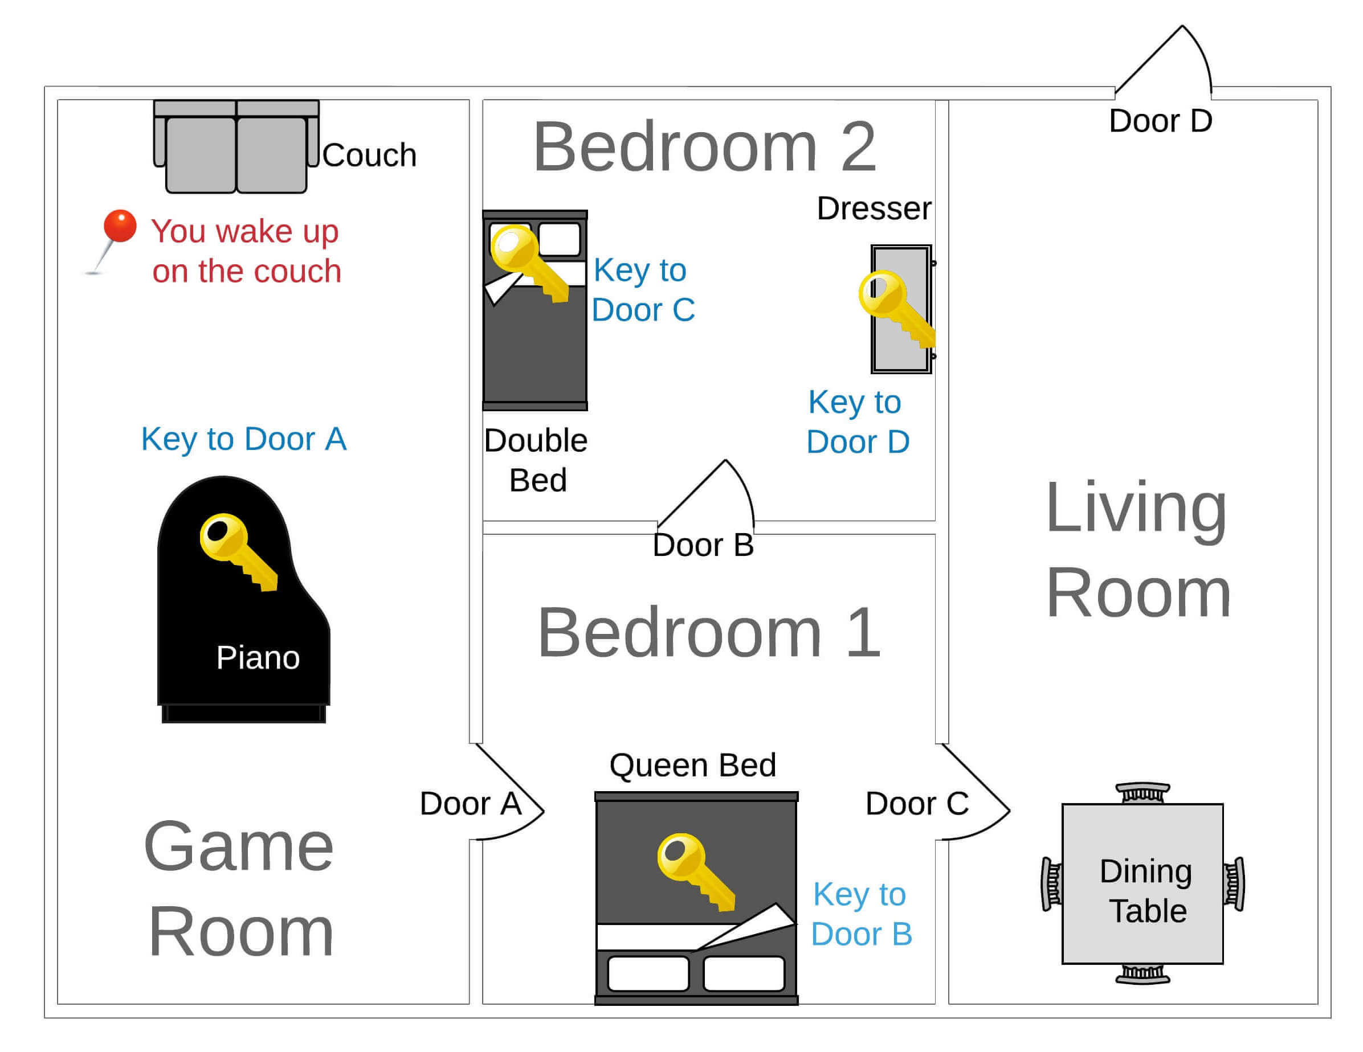

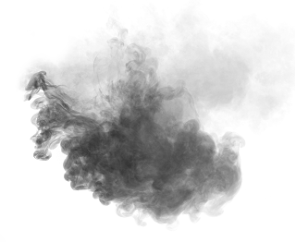
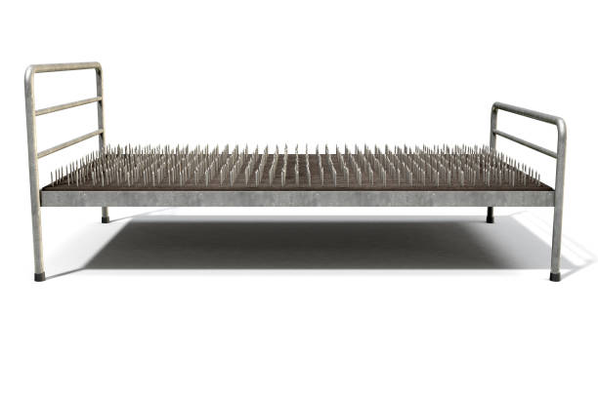

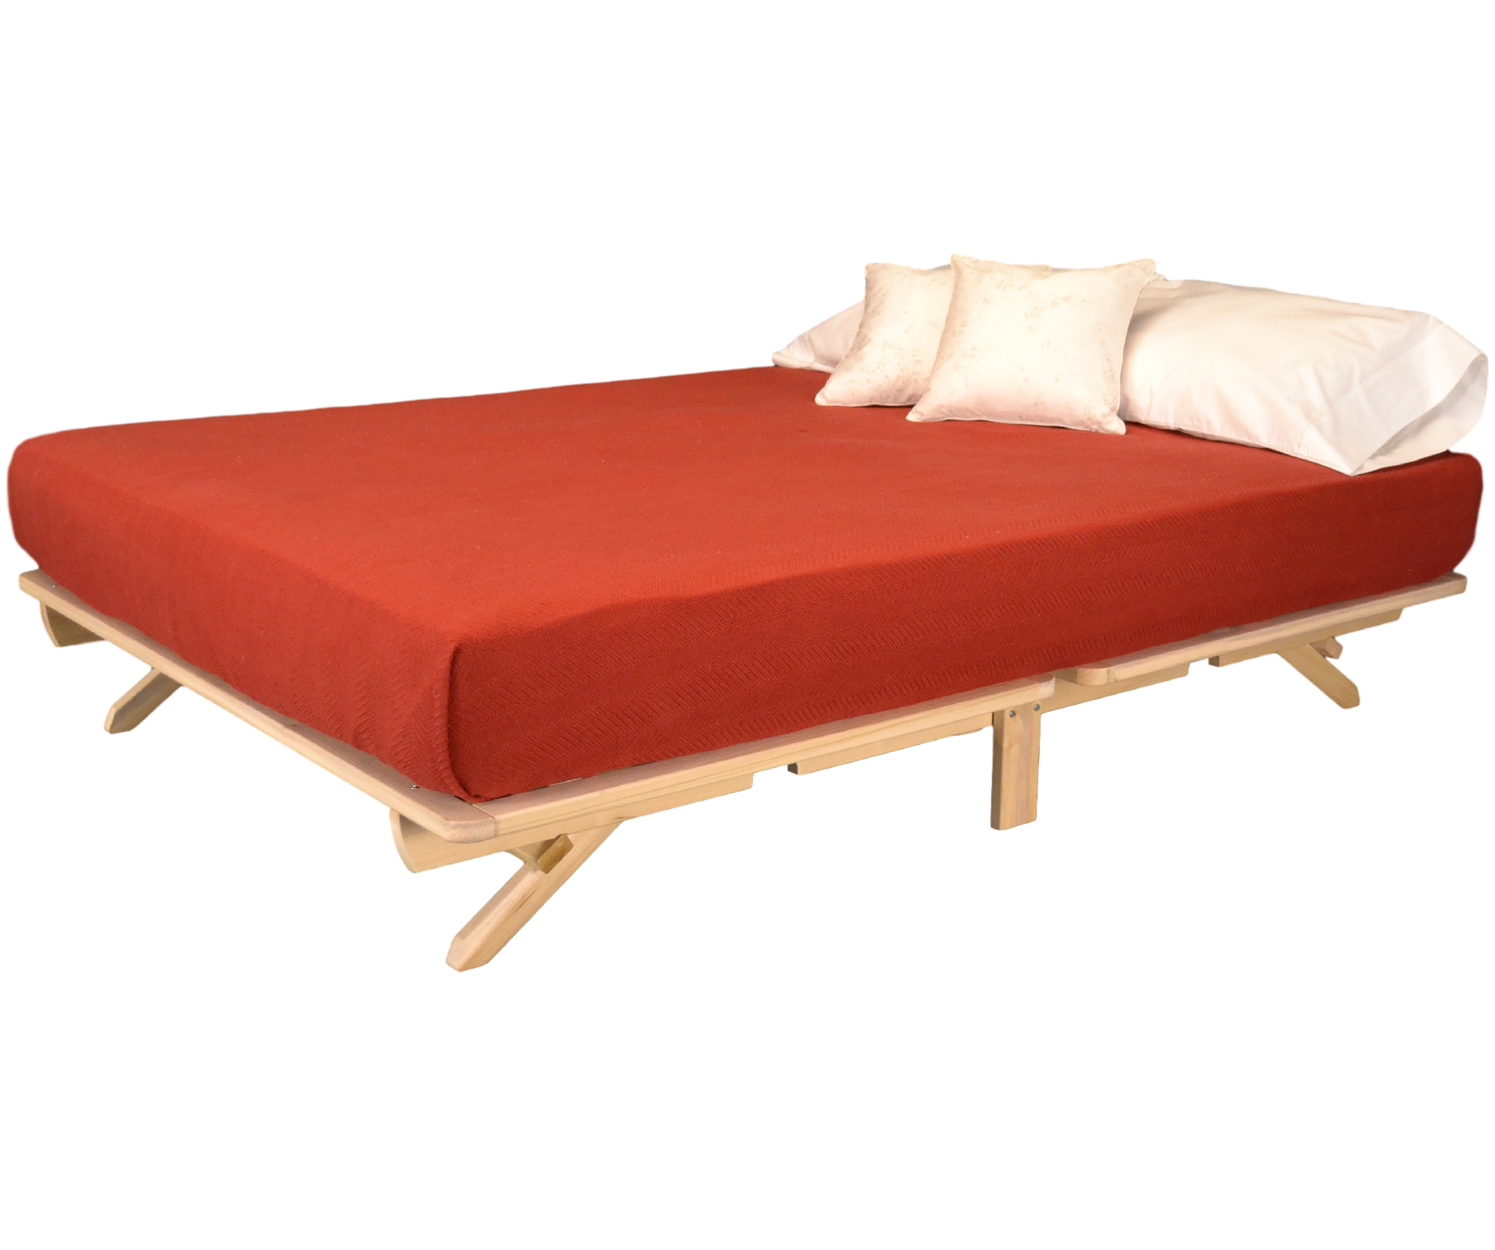

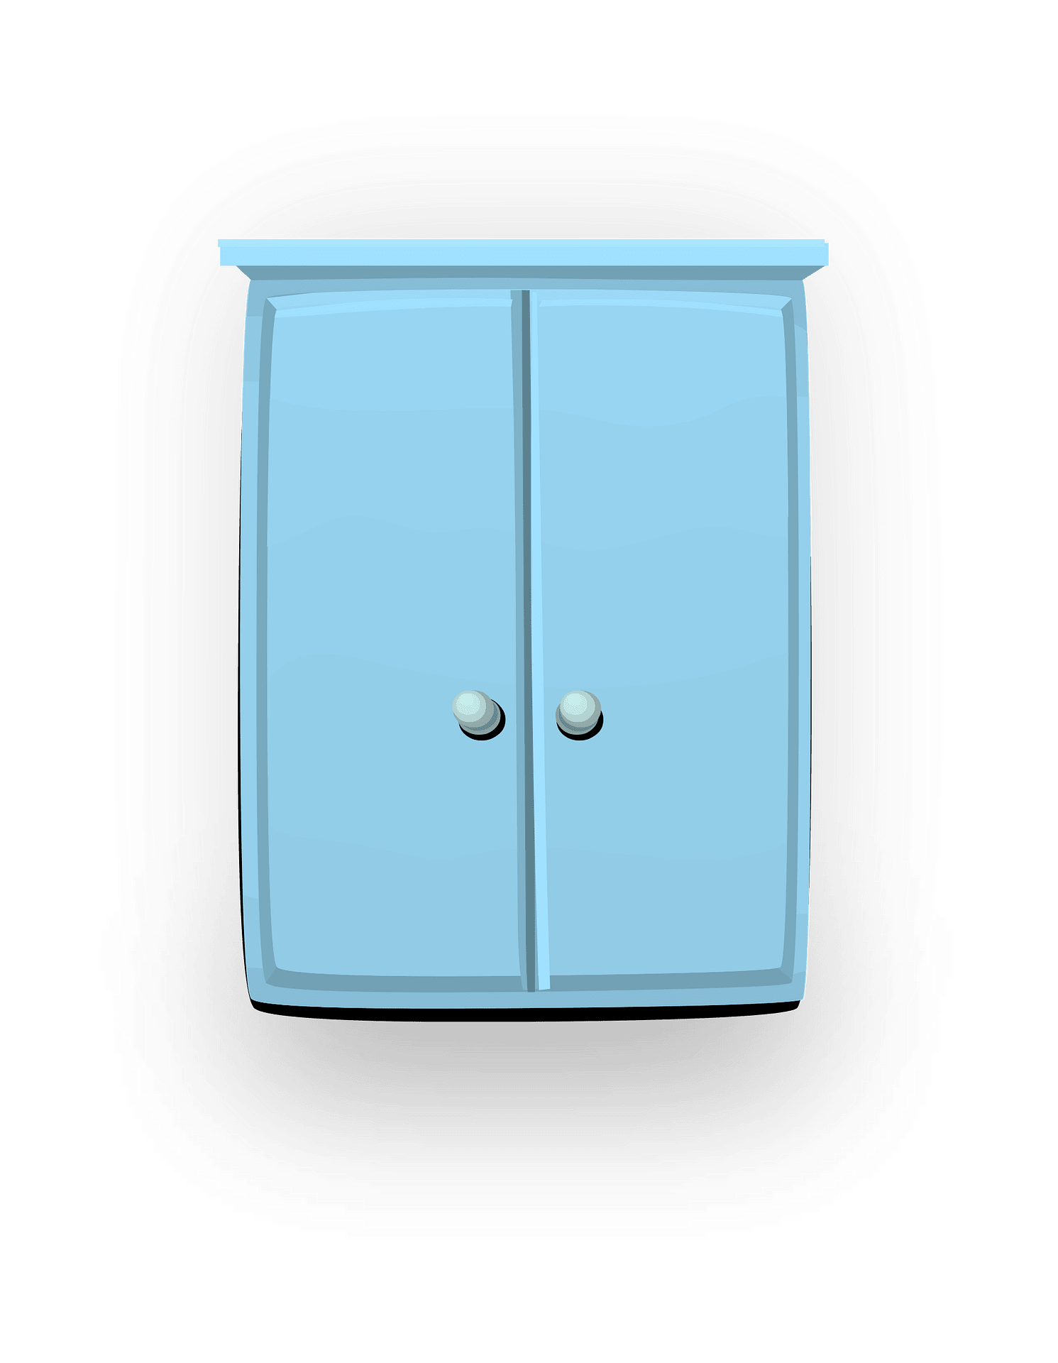



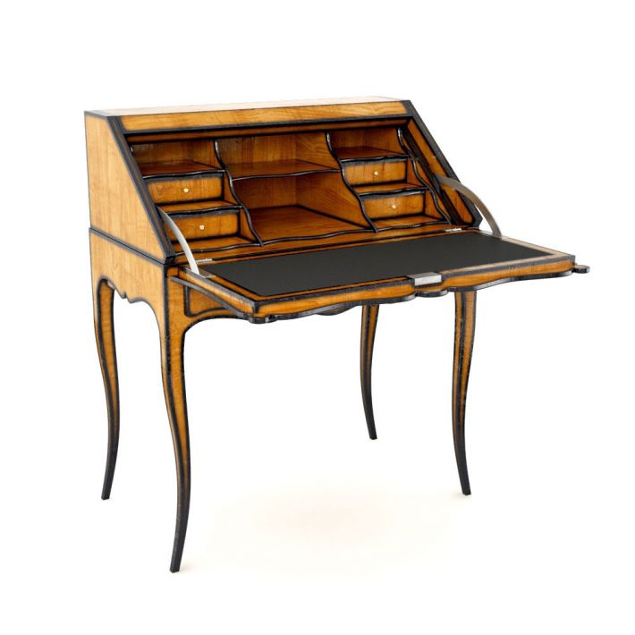
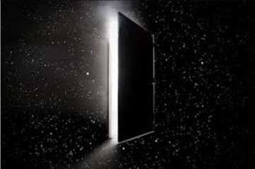

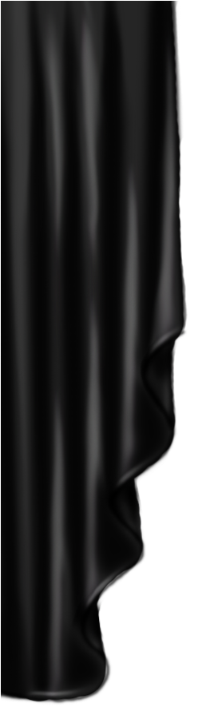
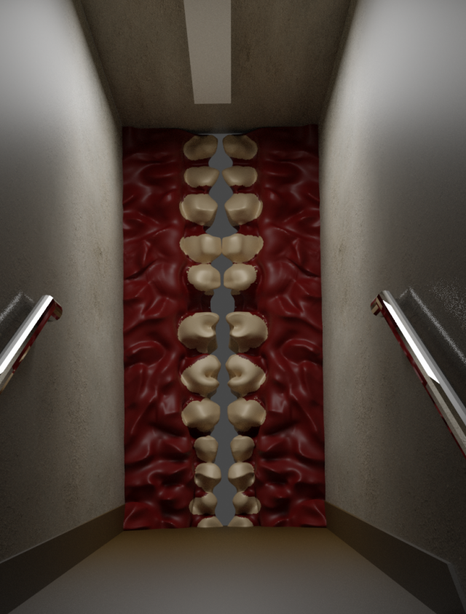
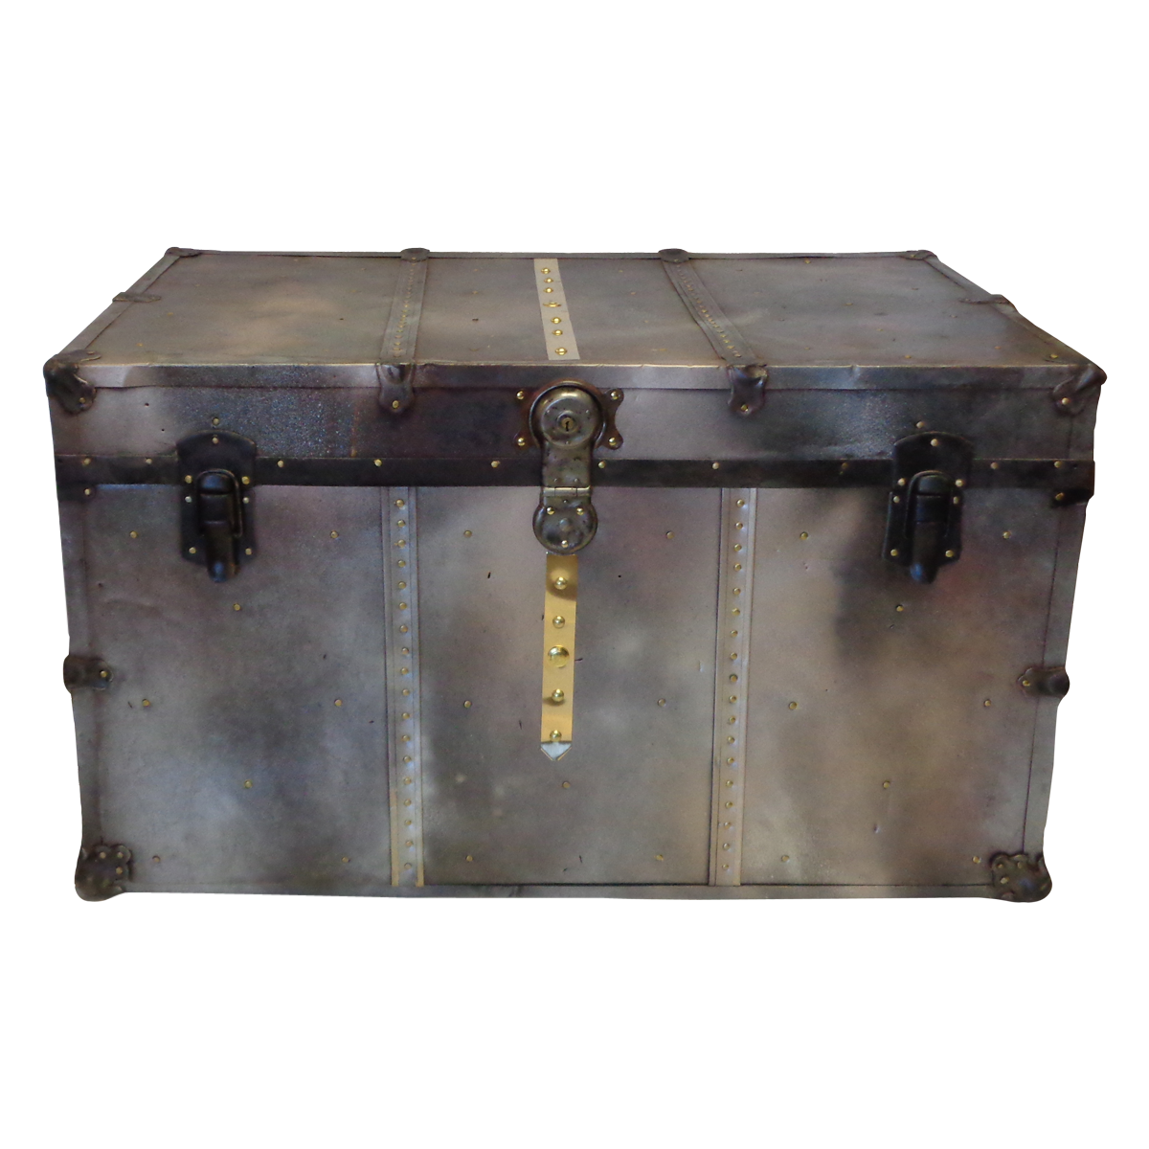
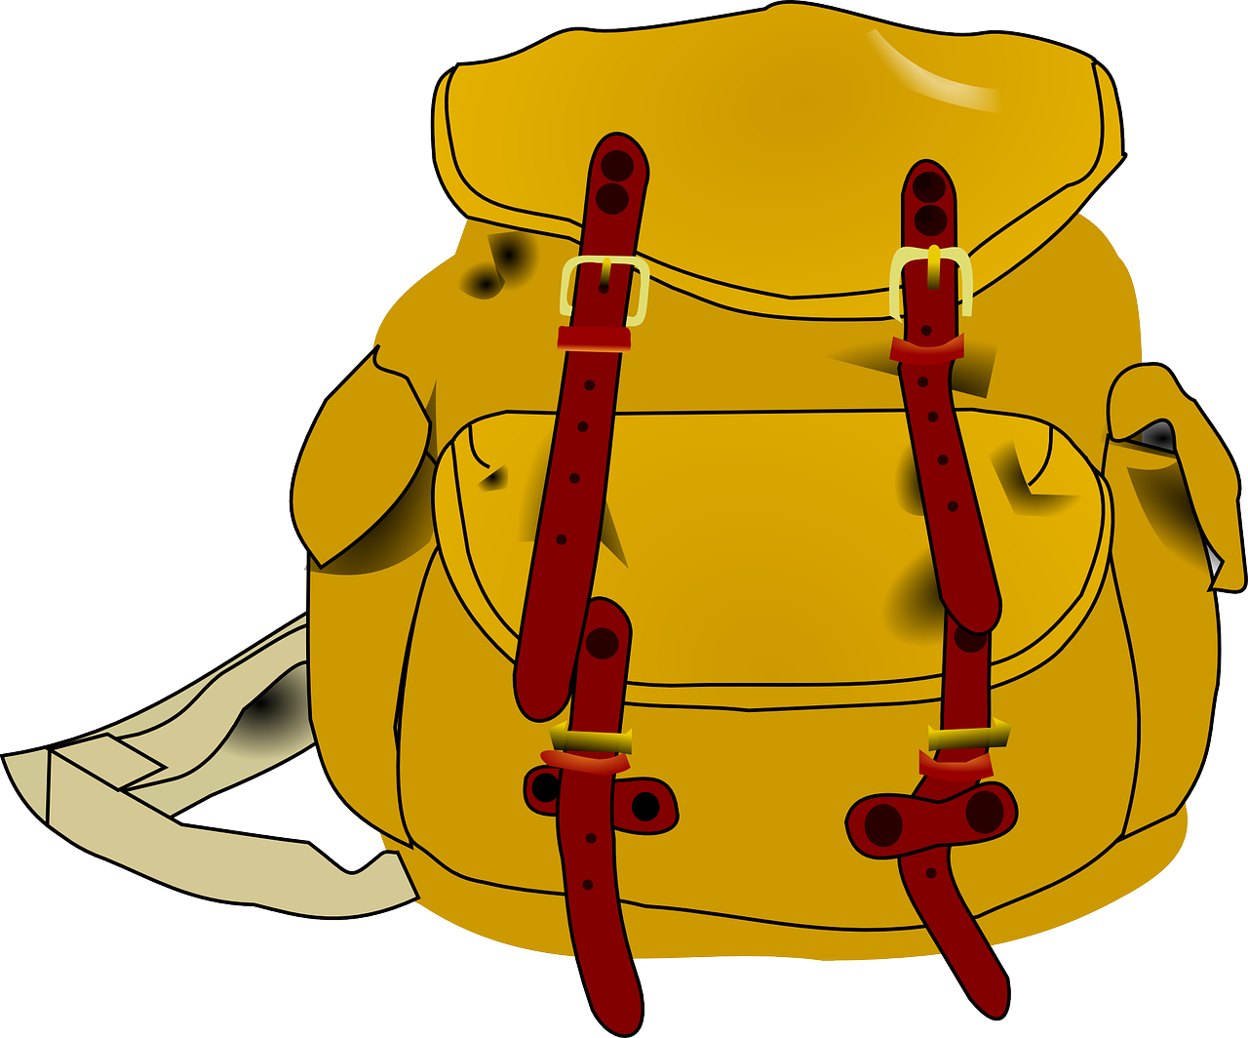

You exit here
Arch of life
Room of Alice
Bed
of nails
Alice’s room
Surreal EscaPY
Functions / Modules
Time()
Random()
Features
Thematic room expansion (MVP)
Timer
Different positioning
Check action
Small pill
WK dresser
You wake up here
Candle-light
RQ Bed
Escritoire
Large pill
Black Hole
Room of reasoning
Diamond
room
Bag of problems
Steel Chest
Insomnia
Room
Diamond
Veil of
Darkness
Diamond room
Mouth
Door

Slide 2
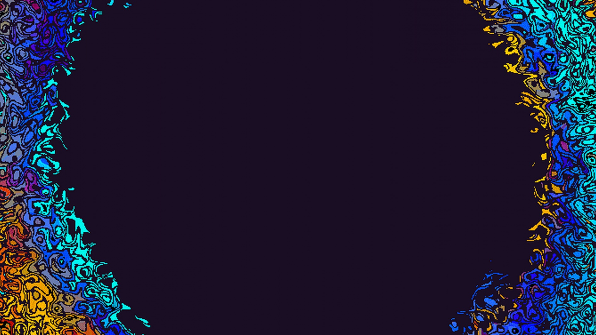
Demonstration
*play (check)
*replay (random)

Slide 3
What we wanted:
Random → spawn location
Check → inventory
Timer → lose condition
Name/Time → Scoreboard

